Slide 1

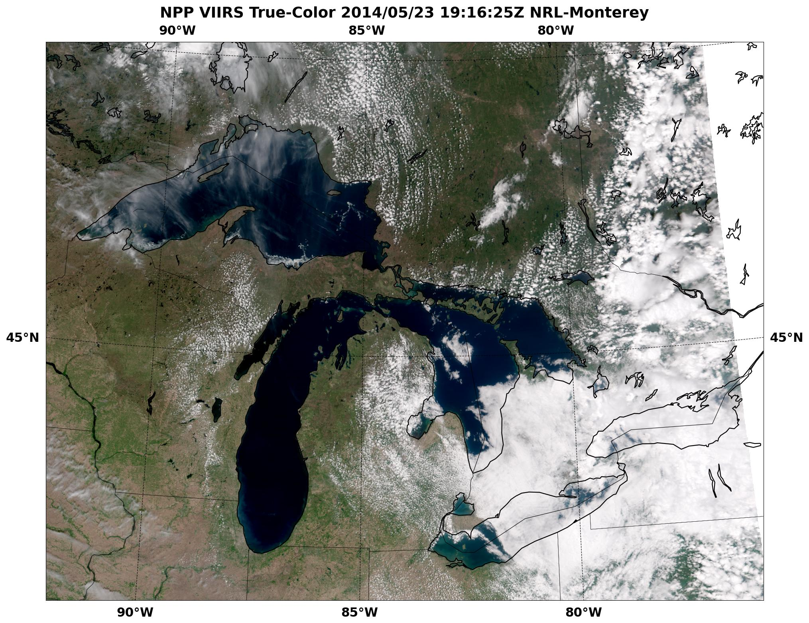
NRL-MRY: NIC VIIRS Great Lakes Demo
5-23-14
Sea Ice
VIIRS True Color Imagery Monitors Great Lakes Ice
Notes:
SNPP VIIRS true color imagery for May 23, 2014 covering the western Great Lakes region using near real-time data from CIMSS direct receive antenna. The product was requested by the NIC during an NRL-MRY visit and created on demand in < 15 minutes and populated on one of our NexSat web directories.
Acknowledgments:
NRL- Naval Research Laboratory, Marine Meteorology Division, Monterey, CA (NRL-MRY):
Jeremy Solbrig, Arunas Kuciauskas, Mindy Surratt, Kim Richardson, Jeff Hawkins, Rich Bankert,
SAIC: John Kent
CSU/CIRA: Steve Miller
VIIRS: NOAA IDPS /AFWA/FNMOC, U. of Wisconsin (CIMSS) direct receive antenna, NOAA CLASS

Slide 2
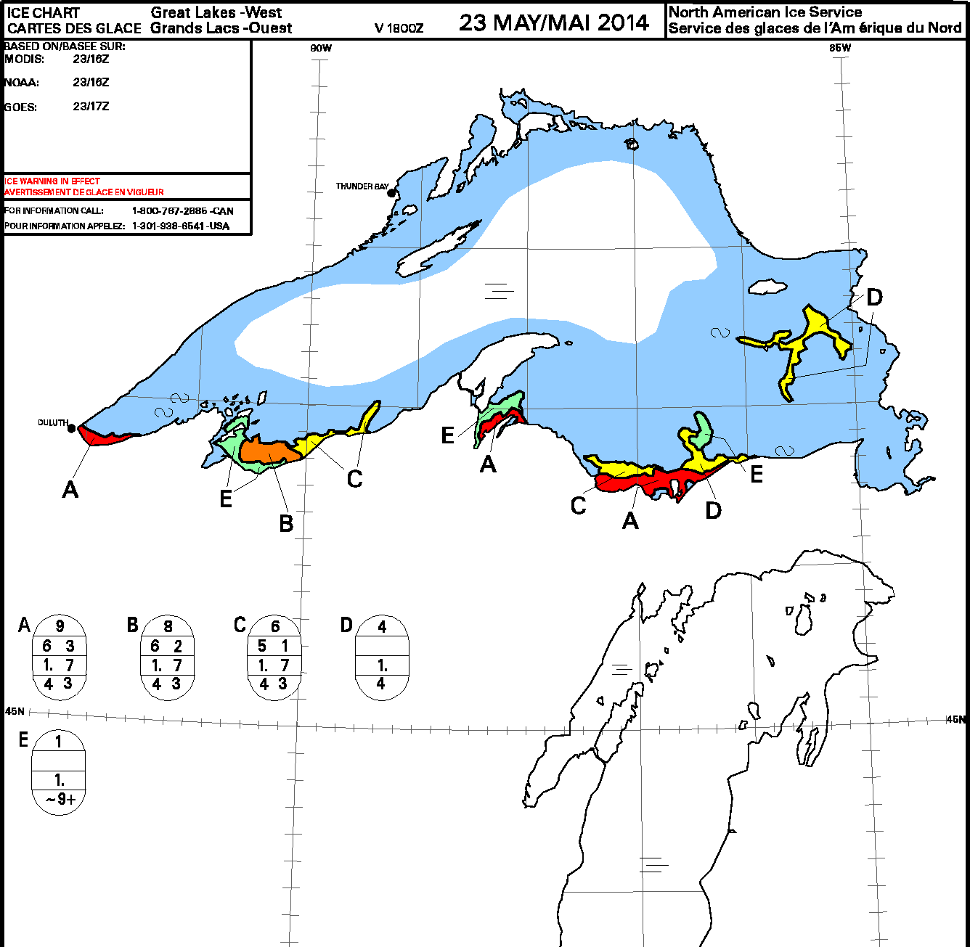
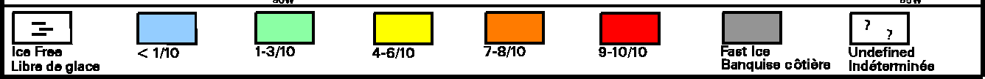
NRL-MRY: NIC VIIRS Great Lakes Demo
NIC
Great Lakes Lake Ice Map
5-23-14
< 1/10 (light blue), isolated lake ice near south shore and Michipicoten Island
Notes:
NIC Great Lakes lake ice map for 5-23-2014 using all data sources. Note isolated ice near the south shore of Lake Superior, late in the season due to the long harsh 2014 winter. < 1/10th ice still covers the near shore areas all around Superior.
Acknowledgments:
NRL- Naval Research Laboratory, Marine Meteorology Division, Monterey, CA (NRL-MRY):
Jeremy Solbrig, Arunas Kuciauskas, Mindy Surratt, Kim Richardson, Jeff Hawkins, Rich Bankert,
SAIC: John Kent
CSU/CIRA: Steve Miller
VIIRS: NOAA IDPS /AFWA/FNMOC, U. of Wisconsin (CIMSS) direct receive antenna, NOAA CLASS
VIIRS: AFWA IDPS/FNMOC, U. of Wisconsin (CIMSS), NOAA CLASS,
FNMOC: Jim Vermeulen, Jeff Tesmer, Yiping Wang, Paul McCrone
Met-9/7, MTSAT, SSM/I, SSMIS, AMSU
NRL-MRY: GOES-WEST/EAST (rooftop antennas)

Slide 3
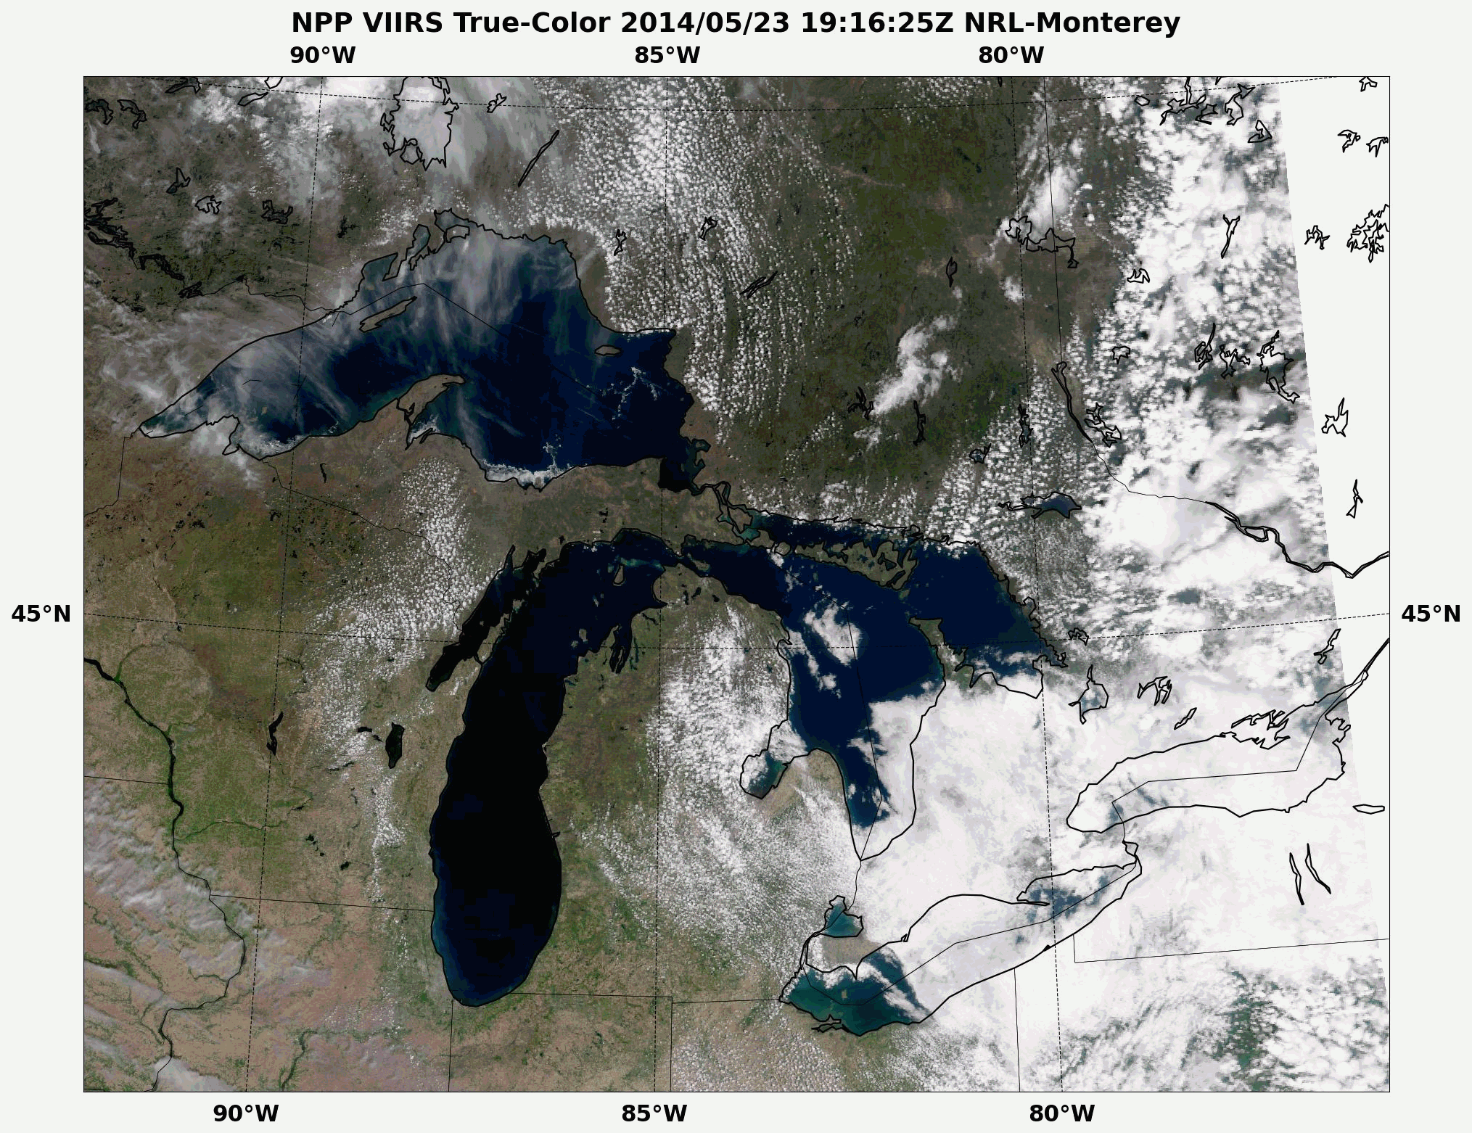
NRL-MRY: NIC VIIRS Great Lakes Demo
Lake Ice
VIIRS True Color Animation
May 23-30 2014
http://www.nrlmry.navy.mil/nexdat/CONUS/focus_regions/ NorthAmerica-CONUS-East/GreatLakes-x-x/
Notes:
SNPP VIIRS true color animation, using best daily coverage once/day from May 23-30, 2014.
Lake ice appears “white” in isolated pockets on the south shore of Lake Superior. There is some hint of very thin lake ice on the north shore, but the concentration is < 10% and thus very difficult to see in this rendition.
Acknowledgments:
NRL- Naval Research Laboratory, Marine Meteorology Division, Monterey, CA (NRL-MRY):
Jeremy Solbrig, Arunas Kuciauskas, Mindy Surratt, Kim Richardson, Jeff Hawkins, Rich Bankert,
SAIC: John Kent
CSU/CIRA: Steve Miller
VIIRS: NOAA IDPS /AFWA/FNMOC, U. of Wisconsin (CIMSS) direct receive antenna, NOAA CLASS

